Slide 1


Managing drugs & alcohol under harmonised legislation
Presented by
Simon Ridge
WA State Mining Engineer

Slide 2

Promote and expand role of risk management
Less reliance on detailed prescription in regulations
Operators will be required to demonstrate an understanding of the hazards and risks that apply to their sites
Operators must eliminate risks or demonstrate effective controls

Slide 3
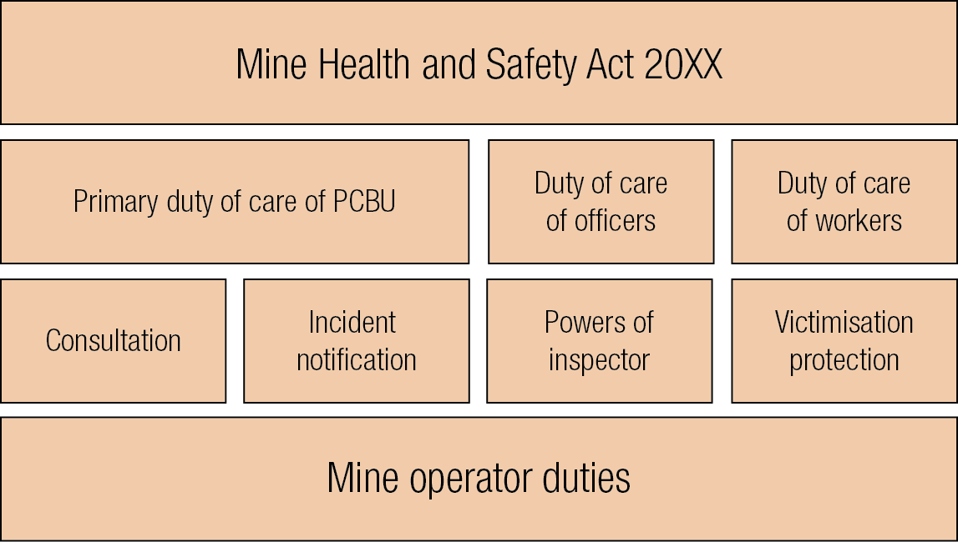
Mine Health and Safety Act 20XX

Slide 4
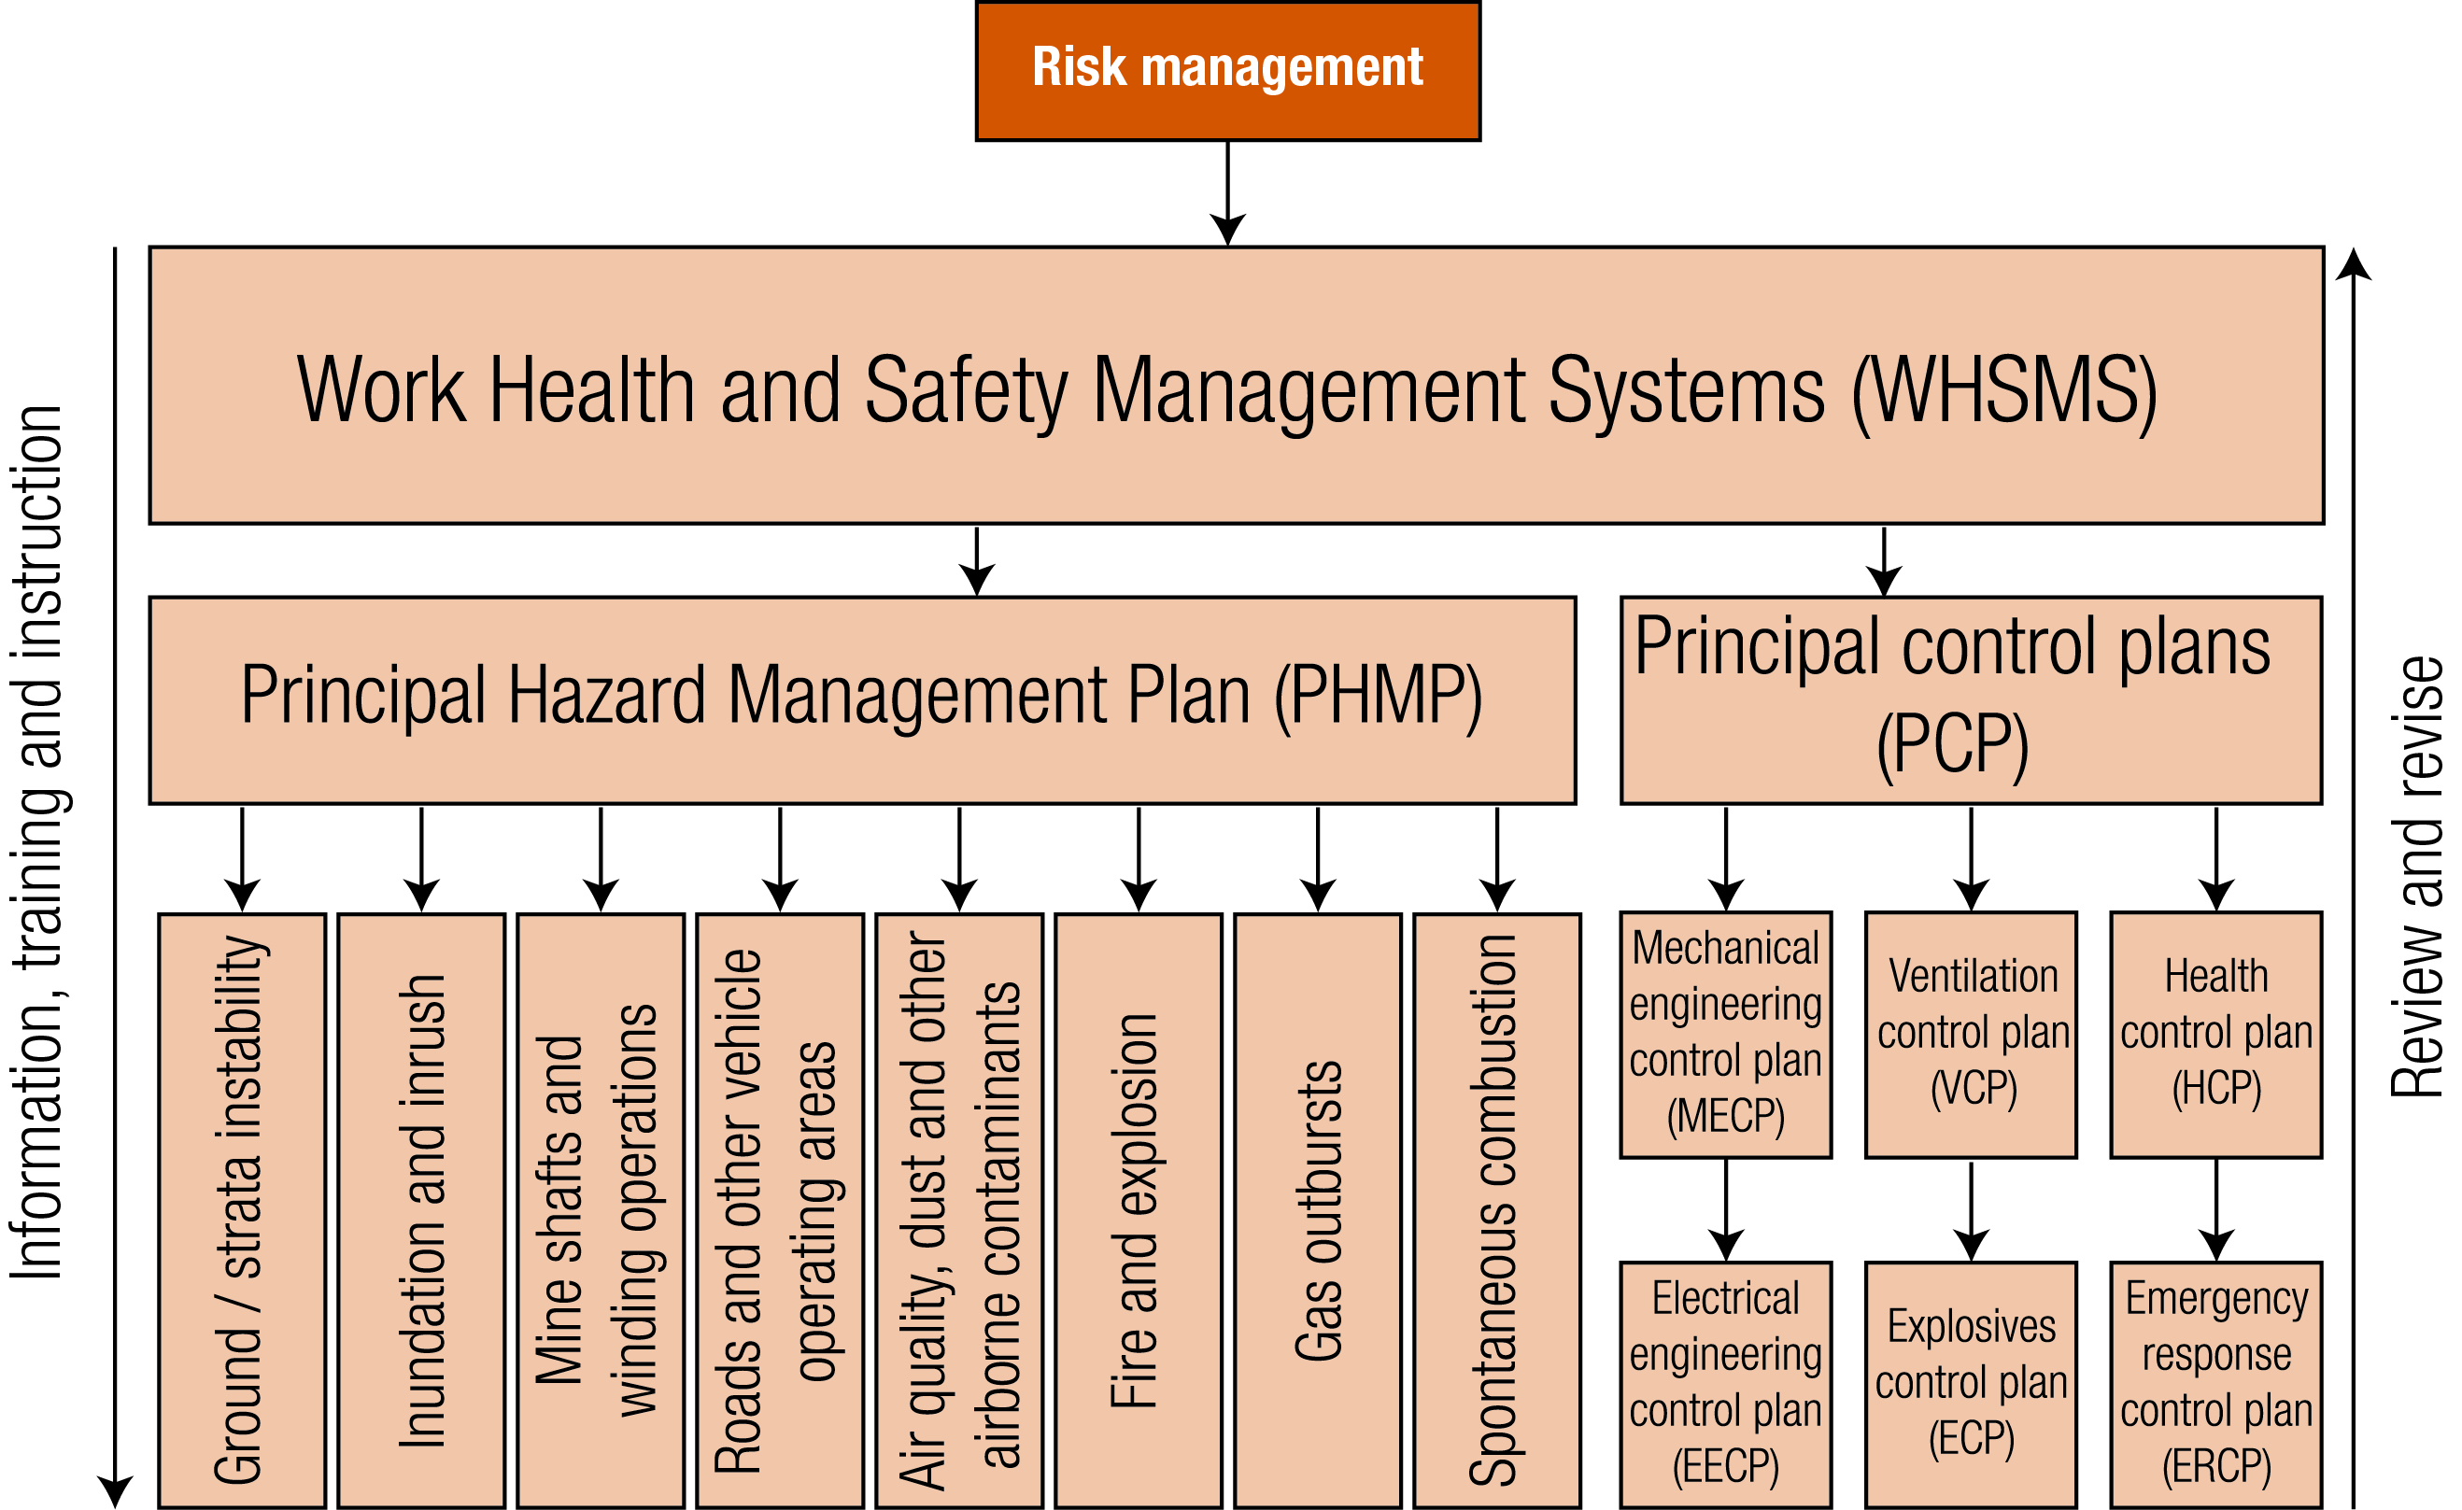

Slide 5
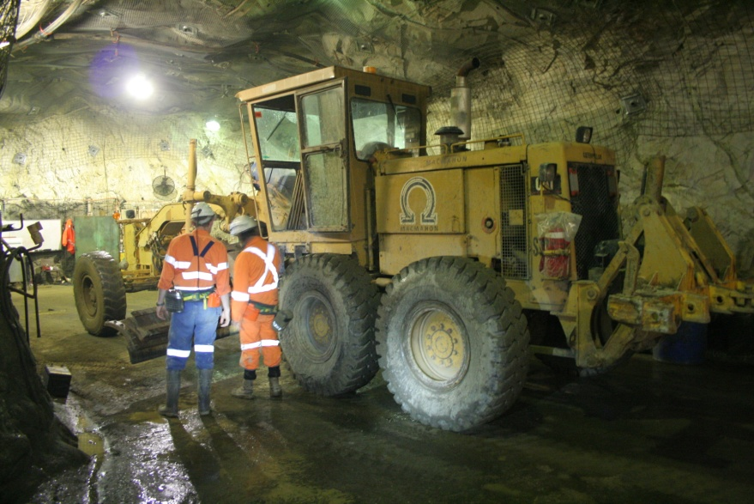
What is required?
Key responsibilities:
  Worker consultation
  Education programs
  Employee Assistance Programs

Slide 6
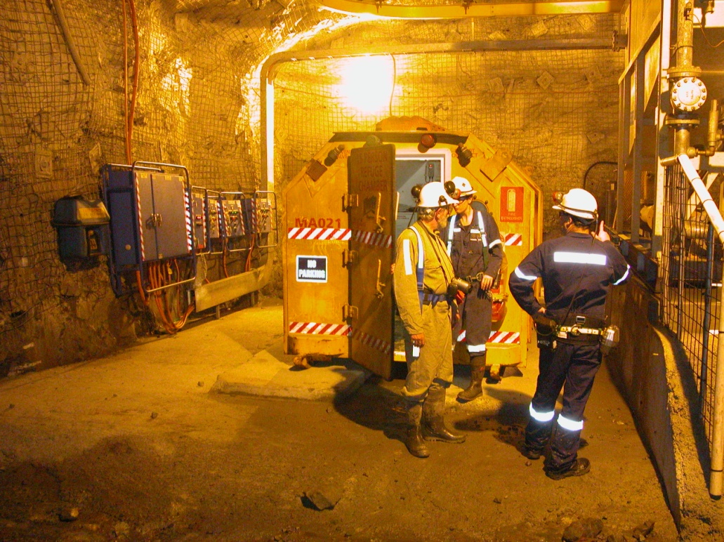
Consultation?
Must cover:
  Testing method and procedures
  Impairment or presence
  Consequences

Slide 7
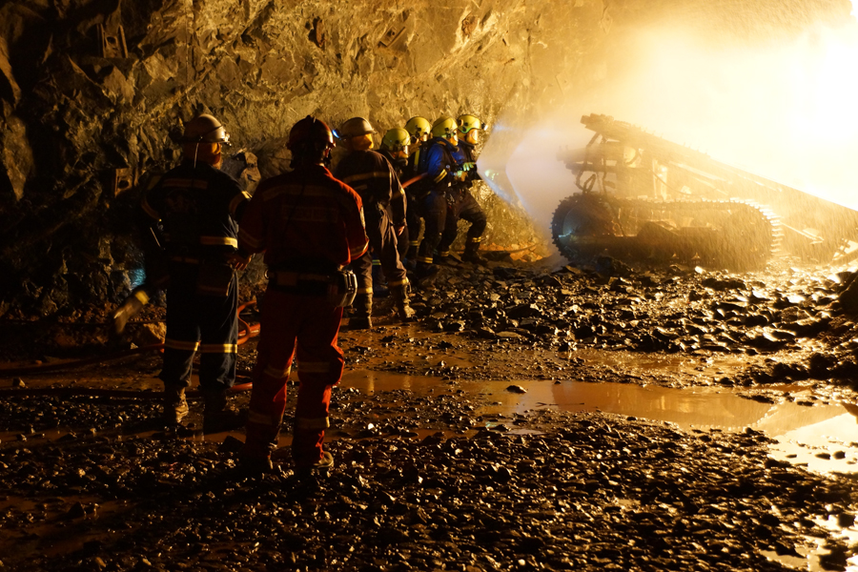
Characteristics:
Robust
  Consistent across site
  Includes contractors

Slide 8
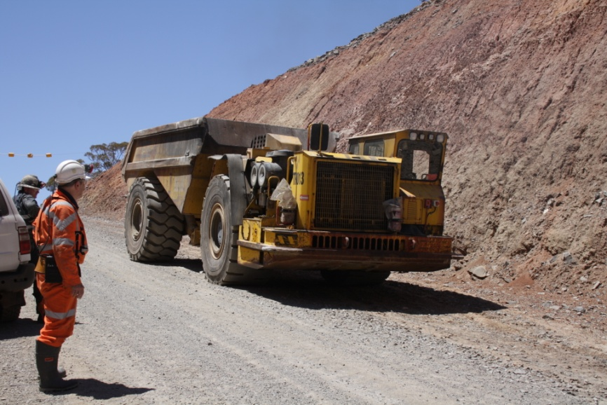
Thankyou

